Slide 1

FRAMEWORK FOR THE DEVELOPMENT OF VILLBOARD : WEB APPLICATION FOR A VILLAGE
NAME : SAFEELA NASRINCK
ROLL NO. : 42
PRODUCT OWNER : MR.VASUDEVAN T

Slide 2

TABLE OF CONTENT
Introduction
Modules
Methodology
Usecase Diagram
Future Enhancement
Developing Environment
Product backlog
User Story
Project Plan
Sprint Plan
Sprint Actual

Slide 3
INTRODUCTION
A village is a community with one administration that manages the whole town with the help of the homeowners.
However, when the population of the community becomes bigger and bigger, it becomes non-manageable.
During the pandemic, all the transactions are online, and homeowners use the internet for updates, news, and announcements inside the village. Also, physical contact would be problematic when they have an appointment, transactions, or report from the admin.
Developing a village management system has a significant impact on both homeowners and the admin of the village.
The use of web applications, homeowners can save time. Instead of going outside to report and pay their monthly maintenance.
For the admin side, it is also a time saver for them because they can do it without going outside.
Making this application could be the first step to having this kind of application in every village for convenience and timing

Slide 4
MODULES
ADMIN
• Login to system
• Approve the post
• Create Announcement
• View Suggestions & Complaint
• Verify User,Pet & Vehicle Registration
• Validate Transaction
• Chatting
STAFF
• Login to sysstem
• View Suggestions & Complaint
• Scan QR Code of Visitors

Slide 5
HOUSEOWNERS
• Login to system
• Register an account
• Create Post
• To make Suggestions & Complaint
• Register Pet & Vehicle Registration
• Payment & upload reciept
• View Announcement
• Chatting with Admin
VISITORS
• Register as visitors

Slide 6
METHODOLOGY

Slide 7
This project is installation of python. Once python is installed we head to the installation of the backbone “django”.
For virtual environment installation:
Python –m install virtualenv
python –m venv virtualenvironment_name
Activated my virtual environment
python virtualenvironment_name/Scripts/activate
Install django by:
python –m pip install django
Start our project as:
python scripts\django-admin.exe startproject proj_name
Runserver
python manage,py runserver
Create an app :
python manage,py startapp blog

Slide 8
Some homeowners want better village security that would register the visitors to have its record to the admin. This application has a feature where the visitor entering the town needs to fill up the information and generate a QR code that scans by the security guards as a way of tracking who is entering the village. Also, registering all the vehicles passing in and out to the village would be more secure for the homeowner.
This Web application help to a village to have its application for their village to further improve their service to the homeowner. In general, developing an application for a village would be helpful for the homeowners; so, they can reach the admin directly by using the application online. Furthermore, they can give suggestions, opinions and report incidents or problems they encounter. Also, using an application to effectively
disseminate announcements, news, and events happening in the village.

Slide 9
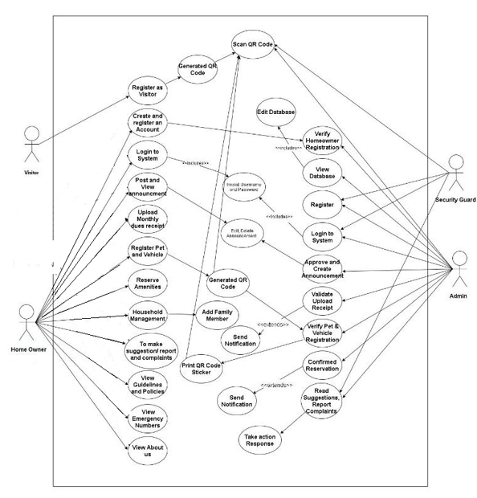
Use Case Diagram
Use Case Diagram

Slide 10
DEVELOPING ENVIRONMENT
HARDWARE SPECIFICATION :
• Processor : i3 or above
• Hard Disk : 500 GB
• RAM : 4 GB

Slide 11
SOFTWARE SPECIFICATION :
• Language : Python
• Front End : Python-Django
• Back end : django
• Database : Sqlite3
• IDE : Visual Studio Code
• OS : Windows/Linux
• Database : Sqlite3

Slide 12
FUTURE ENHANCEMENTS
In this project future work will include developing an application that houseowner can be easliy use and translating the entire system into thier native language and also added more addition activities like payment,call taxi etc.. .

Slide 13
PROJECT PLAN
User Story ID | Task Name | Start Date | End Date | Hours | Status
1 | Sprint 1 | 30/04/2021 | 1/05/2021 | 5 | Completed
1 |  | 5/05/2021 | 15/05/2021 |  | Completed
2 | Sprint 2 | 16/05/2021 | 18/05/2021 | 15 | Completed
2 |  | 20/05/2021 | 24/05/2022 |  | Completed
4 |  | 3/06/2022 | 10/06/2022 |  | Completed
3 | Sprint 3 | 13/06/2022 | 18/06/2022 | 10 | Completed
3 | Sprint 4 | 20/06/2022 | 28/06/2022 | 20 | Completed
3 |  | 30/06/2022 | 1/07/2022 |  | Completed

Slide 14
Thanks!

